Slide 1
Advanced Computer Architecture - Interim
Thomas Parr

Slide 2
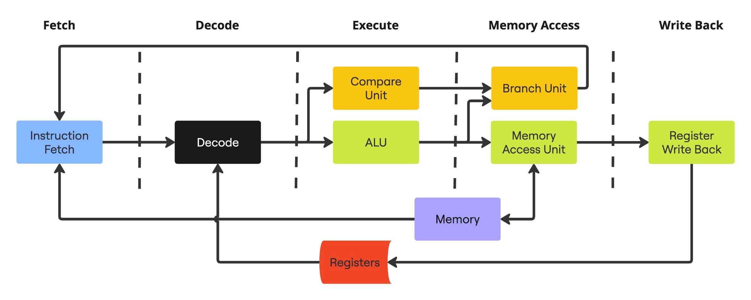
Architecture Diagram

Slide 3
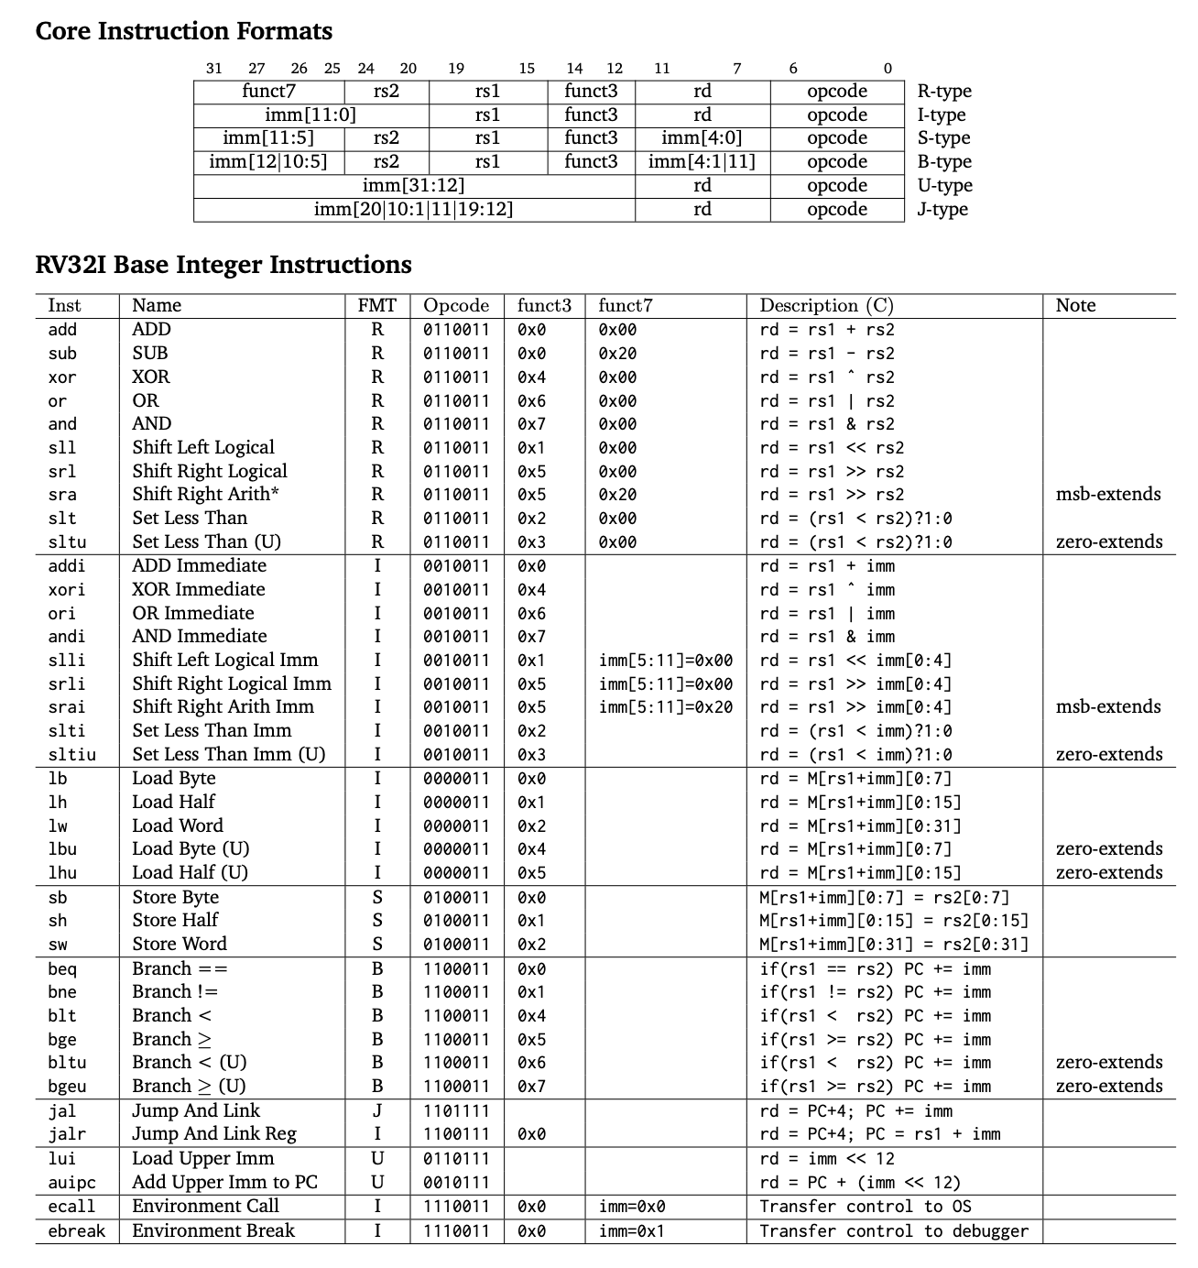
Instruction Set Architecture
https://www.cs.sfu.ca/~ashriram/Courses/CS295/assets/notebooks/RISCV/RISCV_CARD.pdf
Current State
Supports the RISCV base ISA (RV32I), except for fencing and environment calls and breaks.
Main Goals
Add support for RV32M extension for integer multiplication and division
Add support for RV32F extension for floating point operations
Stretch Goals
Support for other extensions, such as the RV32F floating point or the RV32V vector extensions

Slide 4
Architecture Features
Current State
Scalar, non-pipelined processor
Von-Neumann Architecture
Main Goals
Pipelining
Superscalar execution
Multiple duplicate execution units.
Splitting different operations into different execution units
Basic static branch prediction (always take backwards branches)
Out-of-order execution
Tomasulo’s algorithm
Register renaming
Reservation stations
Multiply ISA extension
Floating point extension
Stretch Goals
More advanced dynamic branch prediction (2-bit counter)
Vector ISA extensions

Slide 5
Simulator Features
Text based debugger with:
Stepping through cycles
Breakpoints for instructions
Printing state of all processor components
Using memory location 0 for an “output” from the program
Using a jump instruction to itself to stop simulation of a program
Loading programs from a binary into the memory
Possible Improvements
GUI for:
Surfacing state of different units the processor (inputs and outputs, and current state for registers and memory)
Input and output to running programs

Slide 6
Compilation
Compilation for C code
Uses Docker container with RISCV GCC cross-compiler
Linker script to link all C files and ensure startup program is run first, followed by main
Start-up / shutdown script to initialise the stack pointer at start and stop execution at end
Shell scripts containing pre-defined compiler options for compilation
Currently does not include:
Std library
Multiplication/division
Floating point
.globl _start .section .text.startup _start: # Global pointer .option push .option norelax la x3, __global_pointer$ .option pop # Stack pointer la x2, __stack_top # Reset vector li x1, 0 li x4, 0 li x5, 0 li x6, 0 li x7, 0 li x8, 0 li x9, 0 li x10, 0 li x11, 0 li x12, 0 li x13, 0 li x14, 0 li x15, 0 call main _eoc: j 0
OUTPUT_ARCH("riscv") ENTRY(_start) MEMORY { RAM (rwx) : ORIGIN = 0x0008, LENGTH = 6K } SECTIONS { .text : { *(.text.startup); *(.text); *(.text.*) } > RAM .bss : { *(.bss); *(.bss.*) } > RAM .data : { *(.data); *(.data.*) } > RAM .rodata : { *(.rodata); *(.rodata.*) } > RAM PROVIDE(__global_pointer$ = ORIGIN(RAM) + 0x800); PROVIDE(__stack_top = ORIGIN(RAM) + LENGTH(RAM)); }

Slide 7
Experiments
Current Programs
Simple program which doubles a value and outputs it.
Recursive and iterative Fibonacci algorithms
Plans
Write more thorough benchmark programs to test different features. Plans include:
Sorting algorithms (quick sort)
For floating point implementations: raster renderer or a similar floating point heavy program
Compare throughput between in order and out of order execution.
Compare branch prediction strategies
Compare how the number of duplicate execution units affect cycles per instruction

